Slide 1
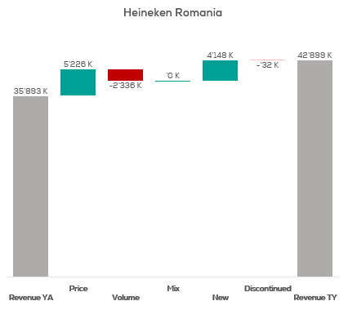
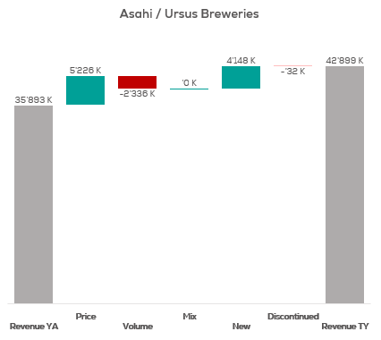
Revenue by Price vs. Volume vs. Mix analysis (Replace with So What)
Revenue by Price vs. Volume vs. Mix analysis | Nicolas vs. Mdd | Effervescents | NATIONAL | P12M
DATA SOURCE: Trade Panel/Retailer Data | Ending June 2025

Slide 2
Revenue by Price vs. Volume vs. Mix analysis (Replace with So What)
Revenue by Price vs. Volume vs. Mix analysis | Nicolas vs. Ruinart | Effervescents | NICOLAS | P12M
DATA SOURCE: Trade Panel/Retailer Data | Ending June 2025

Slide 3
Revenue by Price vs. Volume vs. Mix analysis (Replace with So What)
Revenue by Price vs. Volume vs. Mix analysis | Nicolas vs. Ruinart | Effervescents | NICOLAS QCN | P12M
DATA SOURCE: Trade Panel/Retailer Data | Ending June 2025

Slide 4
Revenue by Price vs. Volume vs. Mix analysis (Replace with So What)
Revenue by Price vs. Volume vs. Mix analysis | Nicolas vs. Ruinart | Effervescents | NICOLAS VCN | P12M
DATA SOURCE: Trade Panel/Retailer Data | Ending June 2025

Slide 5
Revenue by Price vs. Volume vs. Mix analysis (Replace with So What)
Revenue by Price vs. Volume vs. Mix analysis | Nicolas vs. Ruinart | Effervescents | NICOLAS QCT | P12M
DATA SOURCE: Trade Panel/Retailer Data | Ending June 2025

Slide 6
Revenue by Price vs. Volume vs. Mix analysis (Replace with So What)
Revenue by Price vs. Volume vs. Mix analysis | Nicolas vs. Ruinart | Effervescents | NICOLAS QCA | P12M
DATA SOURCE: Trade Panel/Retailer Data | Ending June 2025

Slide 7
Revenue by Price vs. Volume vs. Mix analysis (Replace with So What)
Revenue by Price vs. Volume vs. Mix analysis | Nicolas vs. Ruinart | Effervescents | NICOLAS CCP | P12M
DATA SOURCE: Trade Panel/Retailer Data | Ending June 2025

Slide 8
Revenue by Price vs. Volume vs. Mix analysis (Replace with So What)
Revenue by Price vs. Volume vs. Mix analysis | Nicolas vs. Ruinart | Effervescents | NICOLAS VCT | P12M
DATA SOURCE: Trade Panel/Retailer Data | Ending June 2025

Slide 9
Revenue by Price vs. Volume vs. Mix analysis (Replace with So What)
Revenue by Price vs. Volume vs. Mix analysis | Nicolas vs. Ruinart | Effervescents | NICOLAS RN | P12M
DATA SOURCE: Trade Panel/Retailer Data | Ending June 2025

Slide 10
Revenue by Price vs. Volume vs. Mix analysis (Replace with So What)
Revenue by Price vs. Volume vs. Mix analysis | Nicolas vs. Ruinart | Effervescents | NICOLAS CCQ | P12M
DATA SOURCE: Trade Panel/Retailer Data | Ending June 2025

Slide 11
Revenue by Price vs. Volume vs. Mix analysis (Replace with So What)
Revenue by Price vs. Volume vs. Mix analysis | Nicolas vs. Ruinart | Effervescents | NICOLAS CCC | P12M
DATA SOURCE: Trade Panel/Retailer Data | Ending June 2025

Slide 12
Revenue by Price vs. Volume vs. Mix analysis (Replace with So What)
Revenue by Price vs. Volume vs. Mix analysis | Nicolas vs. Ruinart | Effervescents | NICOLAS IDF | P12M
DATA SOURCE: Trade Panel/Retailer Data | Ending June 2025

Slide 13
Revenue by Price vs. Volume vs. Mix analysis (Replace with So What)
Revenue by Price vs. Volume vs. Mix analysis | Nicolas vs. Ruinart | Effervescents | NICOLAS PAC | P12M
DATA SOURCE: Trade Panel/Retailer Data | Ending June 2025

Slide 14
Revenue by Price vs. Volume vs. Mix analysis (Replace with So What)
Revenue by Price vs. Volume vs. Mix analysis | Nicolas vs. Ruinart | Effervescents | NICOLAS RHO | P12M
DATA SOURCE: Trade Panel/Retailer Data | Ending June 2025

Slide 15
Revenue by Price vs. Volume vs. Mix analysis (Replace with So What)
Revenue by Price vs. Volume vs. Mix analysis | Nicolas vs. Ruinart | Effervescents | NICOLAS AQU | P12M
DATA SOURCE: Trade Panel/Retailer Data | Ending June 2025

Slide 16
Revenue by Price vs. Volume vs. Mix analysis (Replace with So What)
Revenue by Price vs. Volume vs. Mix analysis | Nicolas vs. Ruinart | Effervescents | NICOLAS EST | P12M
DATA SOURCE: Trade Panel/Retailer Data | Ending June 2025

Slide 17
Revenue by Price vs. Volume vs. Mix analysis (Replace with So What)
Revenue by Price vs. Volume vs. Mix analysis | Nicolas vs. Ruinart | Effervescents | NICOLAS OCC | P12M
DATA SOURCE: Trade Panel/Retailer Data | Ending June 2025

Slide 18
Revenue by Price vs. Volume vs. Mix analysis (Replace with So What)
Revenue by Price vs. Volume vs. Mix analysis | Nicolas vs. Ruinart | Effervescents | NICOLAS HAU | P12M
DATA SOURCE: Trade Panel/Retailer Data | Ending June 2025

Slide 19
Revenue by Price vs. Volume vs. Mix analysis (Replace with So What)
Revenue by Price vs. Volume vs. Mix analysis | Nicolas vs. Ruinart | Effervescents | NICOLAS NDI | P12M
DATA SOURCE: Trade Panel/Retailer Data | Ending June 2025

Slide 20
Revenue by Price vs. Volume vs. Mix analysis (Replace with So What)
Revenue by Price vs. Volume vs. Mix analysis | Nicolas vs. Ruinart | Effervescents | NICOLAS BRE | P12M
DATA SOURCE: Trade Panel/Retailer Data | Ending June 2025

Slide 21
Revenue by Price vs. Volume vs. Mix analysis (Replace with So What)
Revenue by Price vs. Volume vs. Mix analysis | Nicolas vs. Ruinart | Effervescents | NICOLAS LOI | P12M
DATA SOURCE: Trade Panel/Retailer Data | Ending June 2025

Slide 22
Revenue by Price vs. Volume vs. Mix analysis (Replace with So What)
Revenue by Price vs. Volume vs. Mix analysis | Nicolas vs. Ruinart | Effervescents | NICOLAS CEN | P12M
DATA SOURCE: Trade Panel/Retailer Data | Ending June 2025

Slide 23
Revenue by Price vs. Volume vs. Mix analysis (Replace with So What)
Revenue by Price vs. Volume vs. Mix analysis | Nicolas vs. Ruinart | Effervescents | NICOLAS BOU | P12M
DATA SOURCE: Trade Panel/Retailer Data | Ending June 2025

Slide 24
Revenue by Price vs. Volume vs. Mix analysis (Replace with So What)
Revenue by Price vs. Volume vs. Mix analysis | Nicolas vs. Ruinart | Effervescents | CA A | P12M
DATA SOURCE: Trade Panel/Retailer Data | Ending June 2025

Slide 25
Revenue by Price vs. Volume vs. Mix analysis (Replace with So What)
Revenue by Price vs. Volume vs. Mix analysis | Nicolas vs. Ruinart | Effervescents | CA B | P12M
DATA SOURCE: Trade Panel/Retailer Data | Ending June 2025

Slide 26
Revenue by Price vs. Volume vs. Mix analysis (Replace with So What)
Revenue by Price vs. Volume vs. Mix analysis | Nicolas vs. Ruinart | Effervescents | CA C | P12M
DATA SOURCE: Trade Panel/Retailer Data | Ending June 2025

Slide 27
Revenue by Price vs. Volume vs. Mix analysis (Replace with So What)
Revenue by Price vs. Volume vs. Mix analysis | Nicolas vs. Ruinart | Effervescents | CA D | P12M
DATA SOURCE: Trade Panel/Retailer Data | Ending June 2025

Slide 28
Revenue by Price vs. Volume vs. Mix analysis (Replace with So What)
Revenue by Price vs. Volume vs. Mix analysis | Nicolas vs. Ruinart | Effervescents | CA E | P12M
DATA SOURCE: Trade Panel/Retailer Data | Ending June 2025

